Slide 1
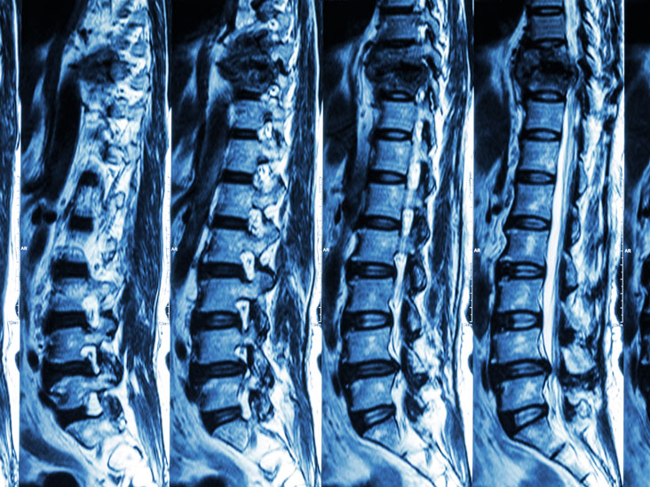
Predicting Spinal Abnormalities using ML

Slide 2
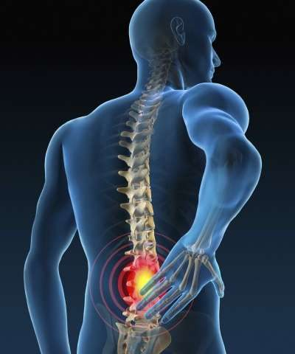
Introduction:
Problem Statement
Lower Back Pain is one of the most common afflictions and our project attempts to find a solution to reduce it. The reason why this is a major issue to be tackled:
Occurs for a large variety of reasons in a large range of age groups.
Ailment is painful and long-lasting.
Difficult to cure quickly and efficiently, if not impossible.
Preventative measures are superior to curative measures.

Slide 3

Introduction:
Our Solution
As we have established, a prevention is better than cure. Hence we will perform accurate mathematical predictions.
We will utilize a variety of Machine Learning Algorithms in order to predict abnormal spine problems. This feature will be made available in an application.
This way, preventative steps can be taken by anyone utilizing this application.

Slide 4
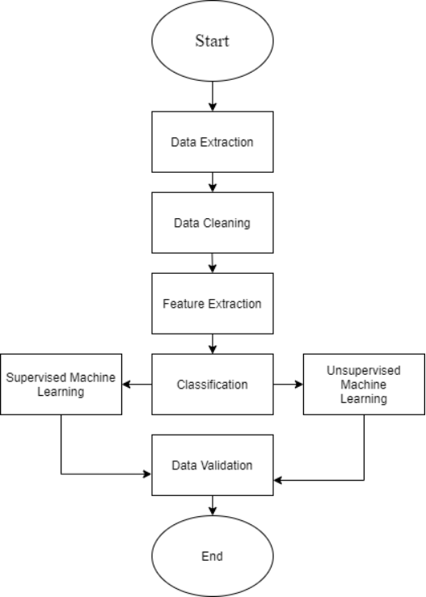
Workflow of Project
We followed a standard machine learning methodology that is generally adopted:
1.Data Extraction - Data to be worked with is retrieved, obtained or collected.
2. Data Cleaning - Corrupt and inaccurate data is checked for and dealt with.
3. Feature Extraction - The data is altered into more manageable groups.
4. Classification - Determine the type of ML Model that is needed.
5. Supervised/Unsupervised ML - Fit the data to the model.
6. Validation - Check if the obtained data matches the expected result.

Slide 5
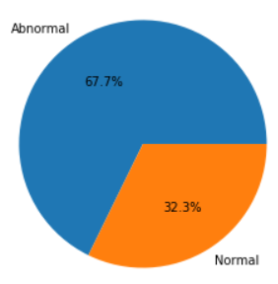
The Data Set
For the project we will be using a data set consisting of the biometric data of 310 patients: 210 Abnormal Cases, 100 Normal Cases.
Biometric Data Present: Pelvic Incidence, Pelvic Tilt, Lumbar Lordosis Angle, Pelvic Radius, etc.
1

Slide 6
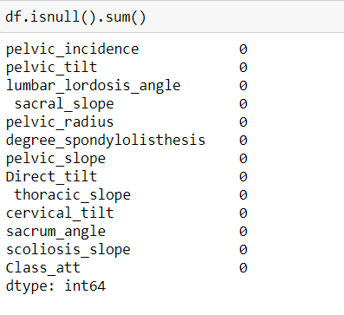
Identifying and handling the missing values
In data preprocessing, it is pivotal to identify and correctly handle the missing values, failing to do this, you might draw inaccurate and faulty conclusions and inferences from the data.
To make sure that there are no missing values, we use a Data Frame class, that contains a function isnull(), which checks for NaN values and returns a boolean value True or False. We further use the sum() method to count the number of NaN, aka, the null values.

Slide 7
Visualization of Data
Histogram of each feature is plotted using the given dataset. It shows the range of the values of the each feature. It is plotted with the help of the hist() function in matplotlib.pyplot, which falls under the matplotlib library.
Distribution and box plots are also plotted using the seaborn library and matplotlib library respectively.
All the features are plotted to find the bivariate relationships between the combinations of variables using a scatter plot matrix.
Finally, a heatmap is plotted to show the correlation among the features of the dataset.

Slide 8
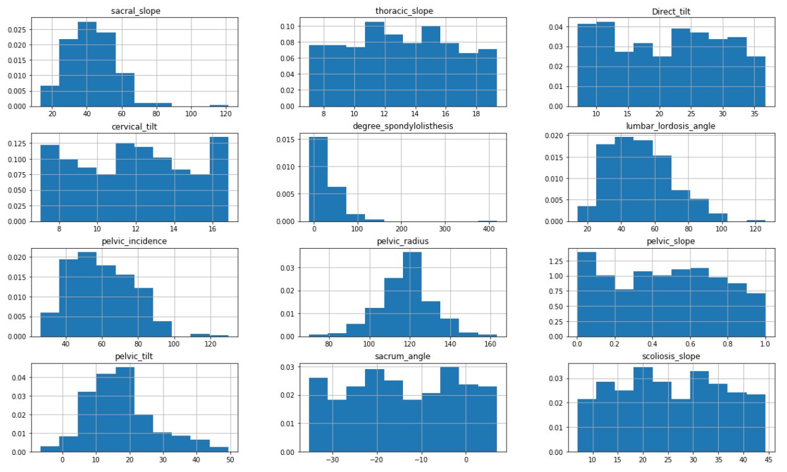
Data Visualization: Histogram

Slide 9
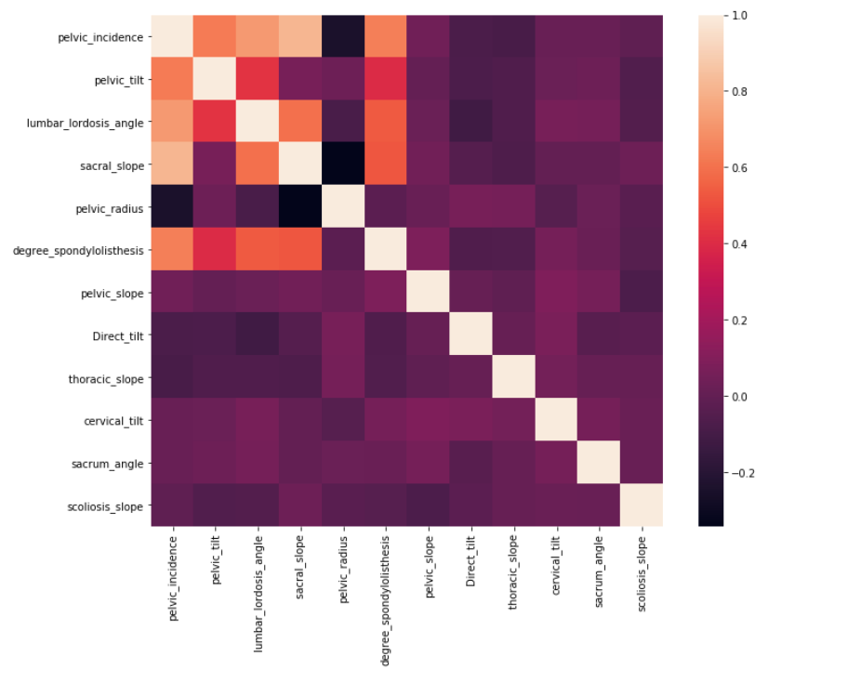
Data Visualization: Heatmap

Slide 10
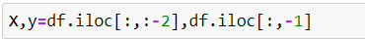
Extraction of values and splitting
We use the iloc[] function, of the Pandas library, to extract the selected rows and columns from the dataset.
.iloc[] is primarily integer position based(from 0 to length-1 of the axis), but may also be used with a boolean array.
Training set denotes the subset of a dataset that is used for training the machine learning model.
A testing set is the subset of the dataset that is used for testing the machine learning model.
Here, we split the dataset into a 66.67% section for training and a 33.33% section for test.

Slide 11
Model Selection and
Discussions

Slide 12
Decision Tree Classifier
Decision Trees are algorithms where the data is continuously split according to a certain parameter.
The tree is explained by two entities called decision nodes and leaves. The leaves are the decisions or the final outcomes, and the decision nodes are where the data is split.
It partitions the tree in recursive manner called recursive partitioning. This flowchart-like structure helps us in decision making.
The time complexity of decision trees is a function of the number of records and number of attributes in the given data. The decision tree is a distribution-free or non-parametric method, which does not depend upon probability distribution assumptions. Decision trees can handle high dimensional data with good accuracy.

Slide 13
Random Forest Classifier
Random forests or random decision forests operate by constructing a multitude of decision trees at training time and outputting the class that is the mode of the classes (classification) or mean prediction (regression) of the individual trees.
There are two stages in RF algorithm, one is random forest creation, and the other is to make a prediction from the random forest classifier created in the first stage.
We take the test features and use the rules of each randomly created decision tree to predict the outcome and stores the predicted outcome (target)

Slide 14
K - nearest Neighbours (KNN) Classifier
K nearest neighbors is a simple algorithm that stores all available cases and classifies new cases based on a similarity measure (e.g., distance functions).
The data is classified by a majority vote of its neighbors, with the case being assigned to the class most common amongst its K nearest neighbors measured by a distance function.
If k = 1, then the case is simply assigned to the class of its nearest neighbor.
We also implement the weighted KNN algorithm in order to predict and classify the data into normal and abnormal spines in this research.
Choosing the number of nearest neighbors, which means determine the value of k plays a crucial role in determining the efficacy of the model. A high k-value has an advantage which includes reducing the variance due to the noisy data.

Slide 15
Deep Neural Network Classifier
TensorFlow is a open-source deep learning library with tools for building almost any type of neural network (NN) architecture. It builds a feedforward multilayer neural network that is trained with a set of labeled data in order to perform classification on similar, unlabeled data.
When we create a DNNClassifier, we need to specify the feature columns (input layer), the architecture of the neural network (hidden layers) and the number of classes (output layer).
Recall that the DNNClassifier builds a feedforward multilayer neural network, hence when we call the function, we need to indicate how many hidden layers we want and how many nodes there should be on each of the layer.

Slide 16
Model Evaluation and Selection
.After exhaustive training on different classification algorithm We choose a small DNN for this task.
We first compared the models based on Accuracy on test set. And if some models were going to be comparable we were going to use evaluation based on F1 score and Area Under the Curve.
But fortunately the small DNN out performed other models by huge margin.So we directly choose it as the final Model.

Slide 17
Graphical User Interface &
Deployment

Slide 18
How to make the Application
We made an simple Windows Application by which a person can use our model get predictions.
For Making the FrontEnd We used the the python Library called Tkinter.
Its a basic Basic GUI Library by which we can create simple and clean Interface.
We have also took care of some basic things such as you can’t submit with all your column being empty.
The Deep Learning Model was used to do the Job.

Slide 19
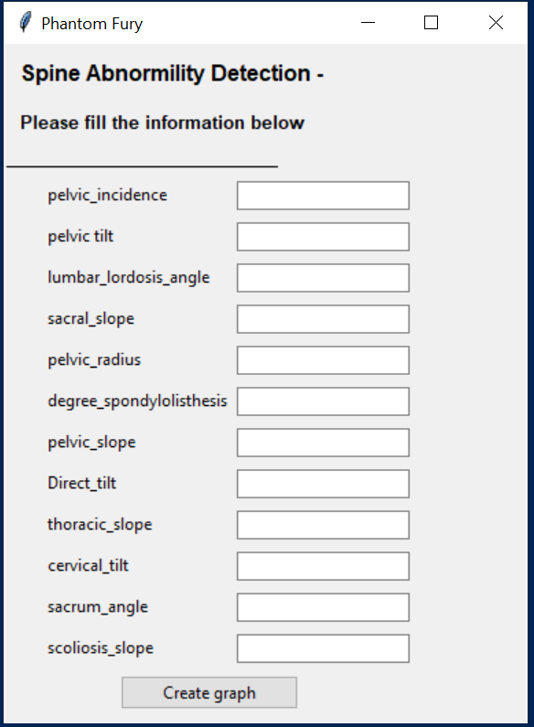
GUI

Slide 20
Conclusion and Future Scope
We have acquired an optimized model that gives 96.45% accuracy as well as a simple GUI that can allow a user to interact with our application.
The following future scope and uses are possible for this project:
Usable by any individuals who have performed preliminary health check-up.
Can be integrated into a application using API, thus increasing platform reach.
Can be utilized directly in medical and health-care industries for classification.
Integrated into a larger scope personalized health-care application.(i.e Mobile App)

Slide 21
References
https://numpy.org/
https://pandas.pydata.org/
https://matplotlib.org/3.1.1/tutorials/introductory/pyplot.html
https://www.tensorflow.org/
https://deepai.org/machine-learning-glossary-and-terms/
Thank You

